Slide 1

CodeStreax : Remote Code Execution Engine Project Presentation
Project Phase 1(ECS799)
Degree : B.Tech CS IBM
Project Guide:
Mr. Amit Singh
Mr. Alok Sharma
AARJAV JAIN (TCA2057001)
LAKSHIKA CHAUDHARY (TCA2057021)
MANRAJ SINGH (TCA2057022)
FACULTY OF ENGINEERING & COMPUTING SCIENCES
TEERTHANKER MAHAVEER UNIVERSITY, MORADABAD

Slide 2


CodeStreax
Achieve unprecedented scalability with the Remote Code Execution Engine. Harness the power of AWS auto scaling group and simple queue service for efficient processing of incoming requests. Ensure security using Docker containers.

Slide 3
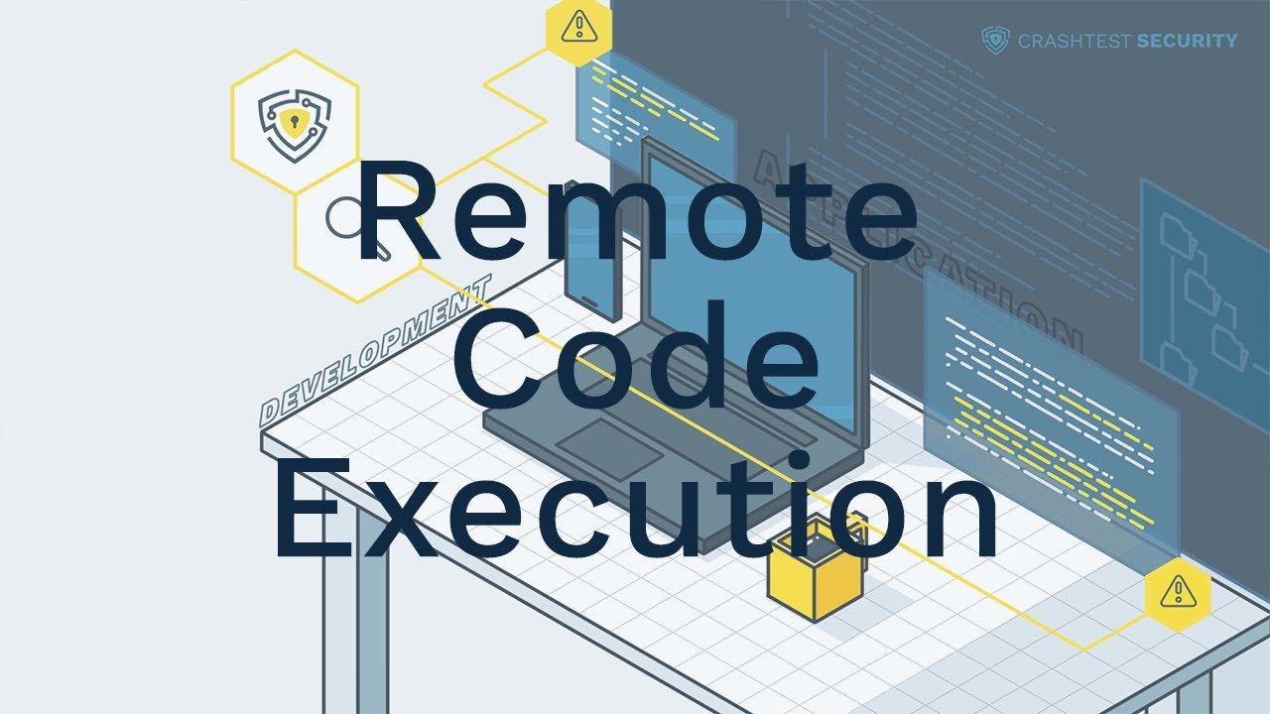
Purpose And Background
The remote code execution engine, provides a virtual coding environment for users to execute and test their code remotely. Designed to enhance coding skills, it enables real-time assessment of algorithms and problem-solving proficiency, fostering an interactive platform for learning and practicing programming in a collaborative and competitive manner.

Slide 4

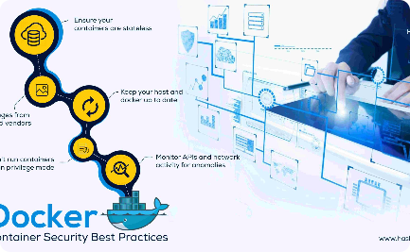
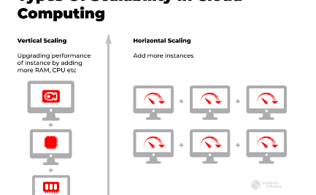

Module Description
User-Friendly Interface
High Security
Horizontal Scaling
Amazon SQS
Easily navigate through the intuitive interface of the Remote Code Execution Engine. Simplify the process of solving complex data structures and algorithm problems, allowing programmers to focus on what truly matters.
Ensure optimal security with the Remote Code Execution Engine's utilization of Docker containers. Shield your system against untrusted code by encapsulating it within isolated containers, delivering peace of mind to users.
Experience the power of horizontal scaling as the Remote Code Execution Engine seamlessly integrates with AWS auto scaling group. Effortlessly adapt to varying workloads, maximizing performance and efficiency.
Streamline the handling of incoming requests through the Remote Code Execution Engine's integration with AWS Simple Queue Service. Ensure smooth and efficient workflow, benefiting both users and administrators.

Slide 5

Efficient Request Handling
1
Simple Queue Service
Streamline the handling of incoming requests through the Remote Code Execution Engine's integration with AWS Simple Queue Service. Ensure smooth and efficient workflow, benefiting both users and administrators.
2
Robust Workflow
By leveraging the power of AWS Auto Scaling Groups, the Remote Code Execution Engine optimizes the processing of requests. Seamlessly manage a large number of tasks, allowing for uninterrupted operations.
3
Timely Response
With the Remote Code Execution Engine and its integration with AWS Simple Queue Service, timely responses to incoming requests are guaranteed. Empower users to achieve their goals quickly and efficiently.

Slide 6
Benefits and Advantages
Unmatched Scalability
Enhanced Security
Take advantage of AWS auto scaling group to effortlessly scale your system according to the demand. Eliminate performance bottlenecks and keep your application running seamlessly.
Ensure the highest level of security by containerizing untrusted code with Docker containers. Safeguard your system from potential vulnerabilities and malicious attacks.
Optimized Workflow
User Satisfaction
With efficient request handling through AWS Simple Queue Service, optimize your workflow and maximize productivity. Smoothly manage and process incoming requests, ensuring an uninterrupted user experience.
Deliver exceptional user experiences by providing a user-friendly interface for solving data structures and algorithm problems. Empower programmers to efficiently solve complex tasks, leading to higher satisfaction rates.

Slide 7
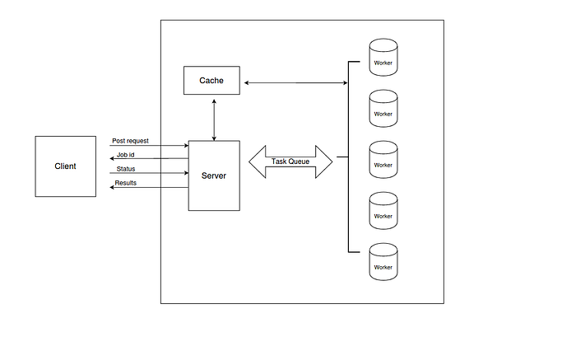

SYSTEM DESIGN
The client makes a post request which contains the source code , choice of programming language , input (if required) and the time limit. The server responds back with a unique job id.
The server then pushes this request in a task queue which will be processed by one of the many worker nodes.
The worker node will run the program in a secure environment so that the program wont cause any harm to the system. Once the execution is completed the worker node updates the status in the cache-box (with a certain expiry) and sends an acknowledgement to the task queue.
In case of a positive acknowledgement the task queue deletes that task else in case of a negative acknowledgement the task is not deleted.
Client can do a get request to with appropriate job id to get the results or a appropriate status (Added to queue, running)

Slide 8
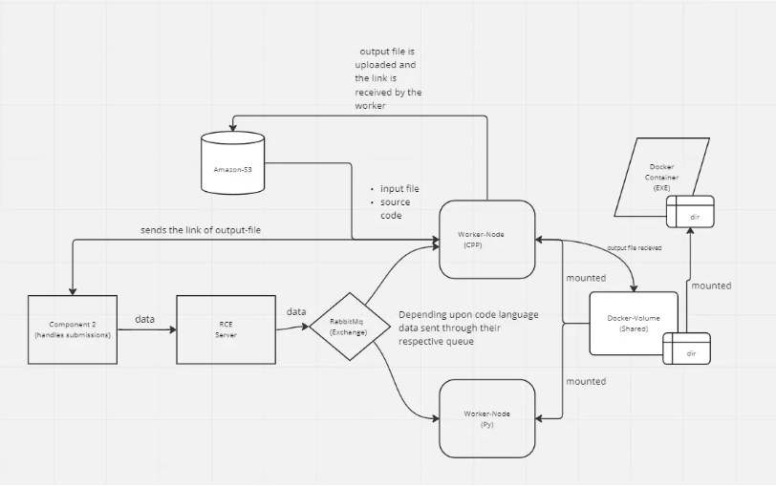
DFD

Slide 9
Hardware & Software Requirement:
Hardware Requirements:
Processor (CPU): Intel Pentium 4 processor or later
Memory (RAM): 512mb or higher
Storage: 10gb or higher
Network Interface: A reliable and high-speed network connection is crucial
Software Requirements:
Operating System (OS): Microsoft Windows Xp or Later or equivalent
Web Browser: Microsoft Edge Or Chrome or Firefox

Slide 10



Technologies
FrontEnd:
NextJs
HTML
CSS

Slide 11




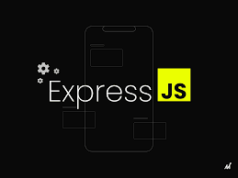
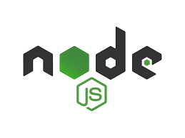
Technologies
BackEnd:
AWS
Docker
Prisma
PostgreSql
ExpressJs
Nodejs

Slide 12
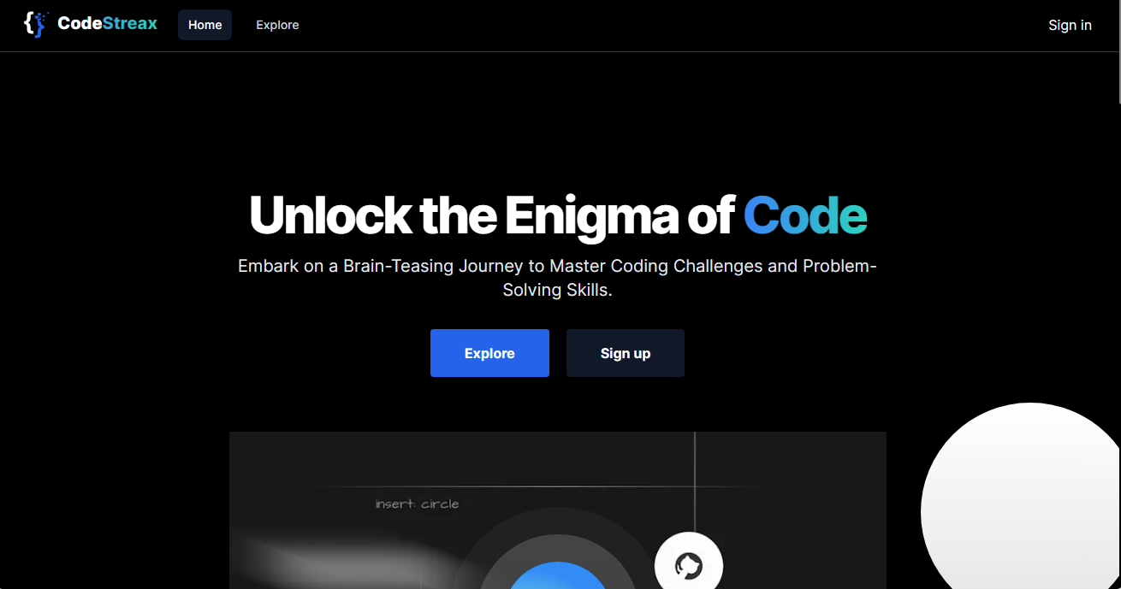
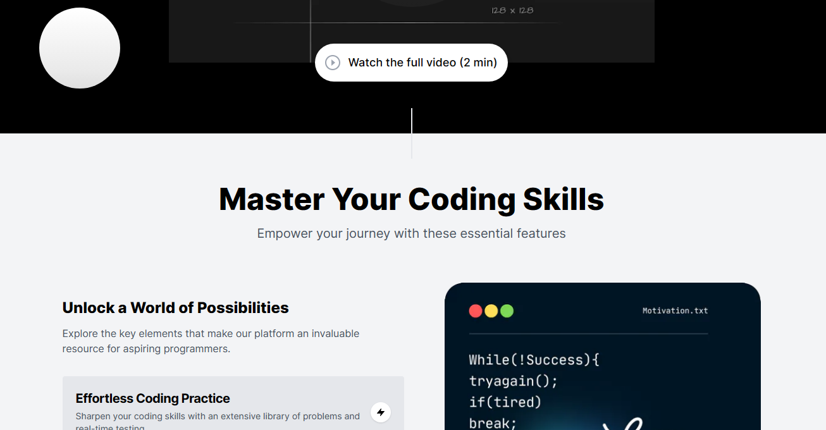
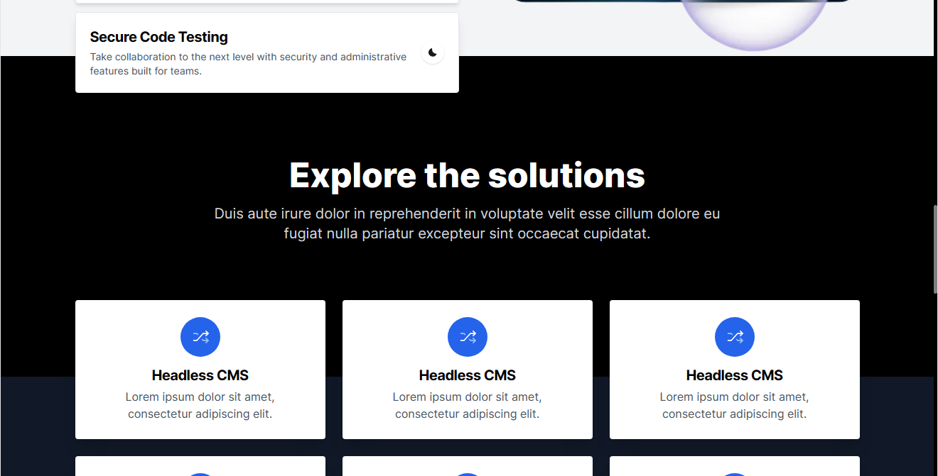
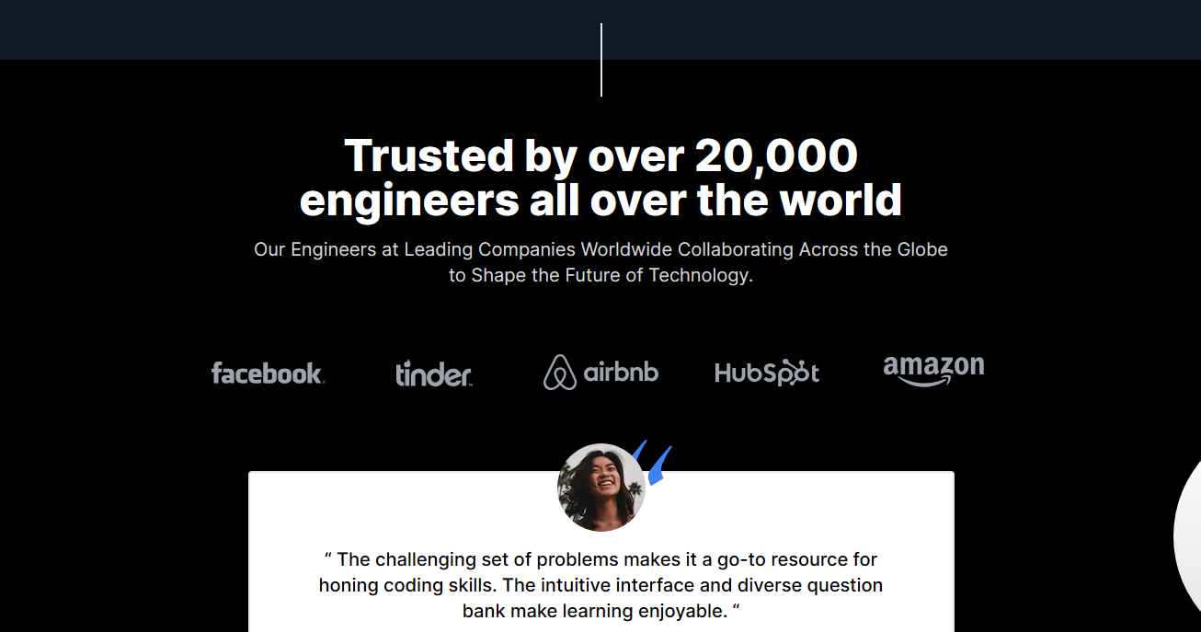
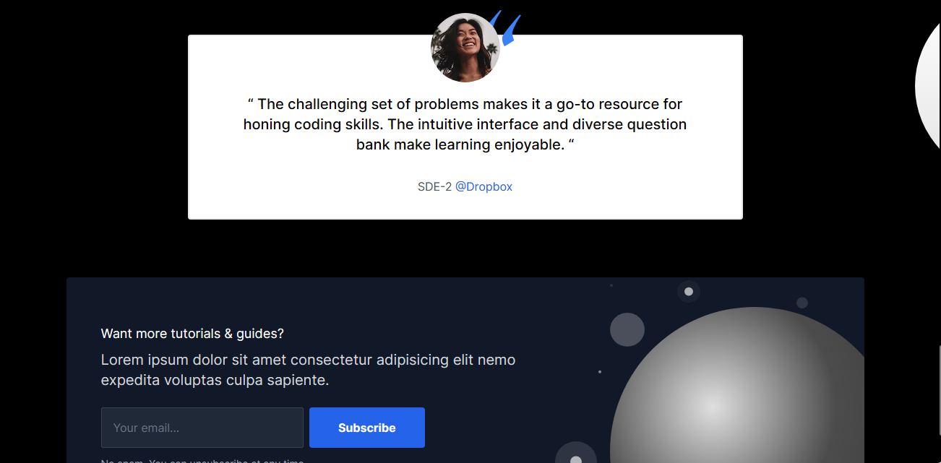

Snapshots
HomePage:

Slide 13
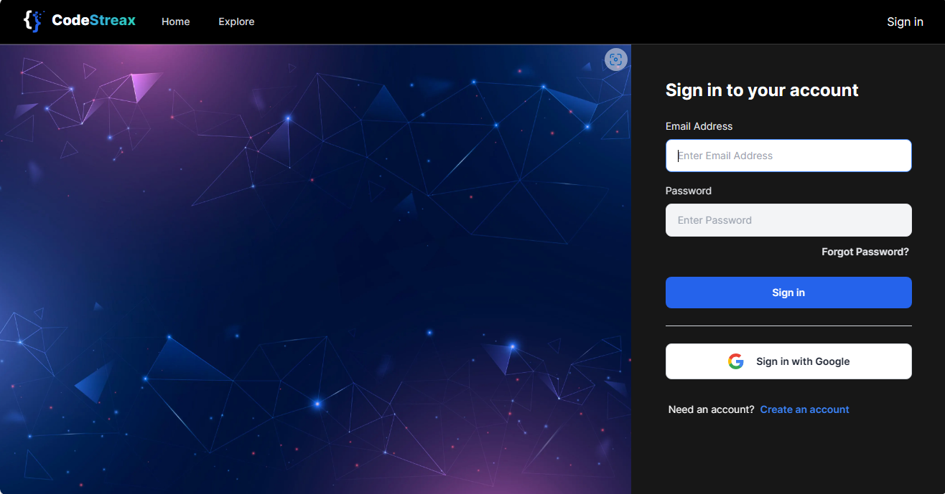
Login Page:

Slide 14
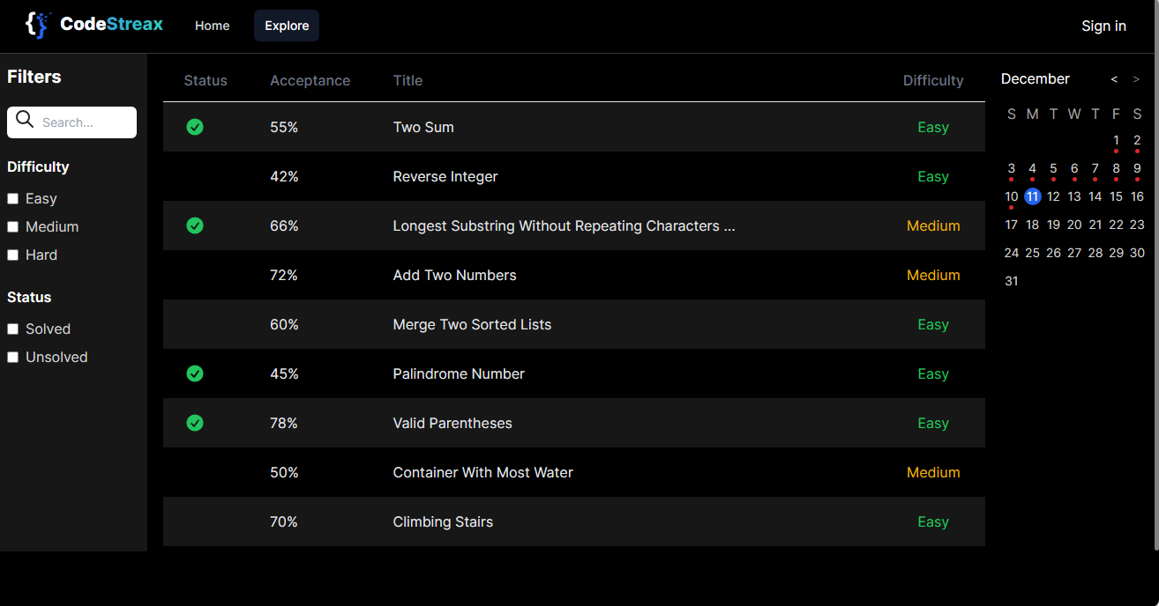
Explore Page:

Slide 15
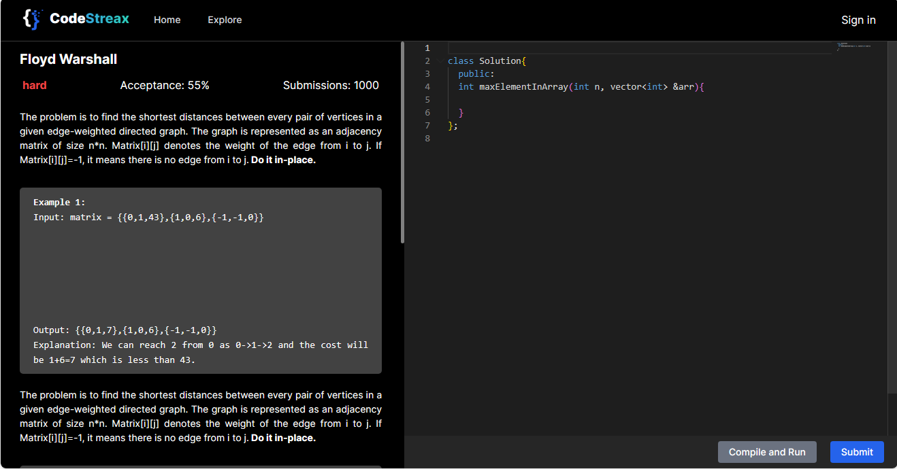
Code Submission Page:

Slide 16
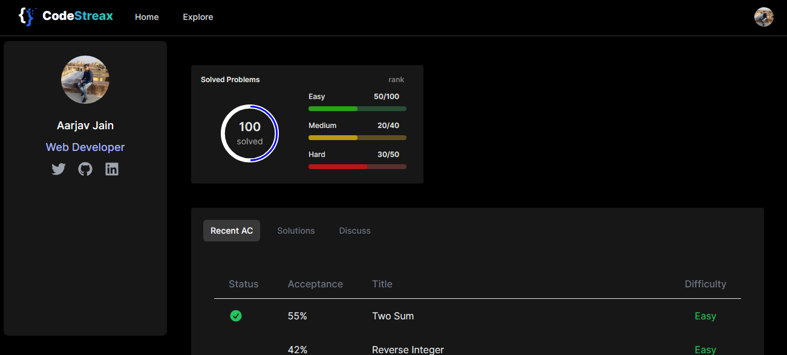
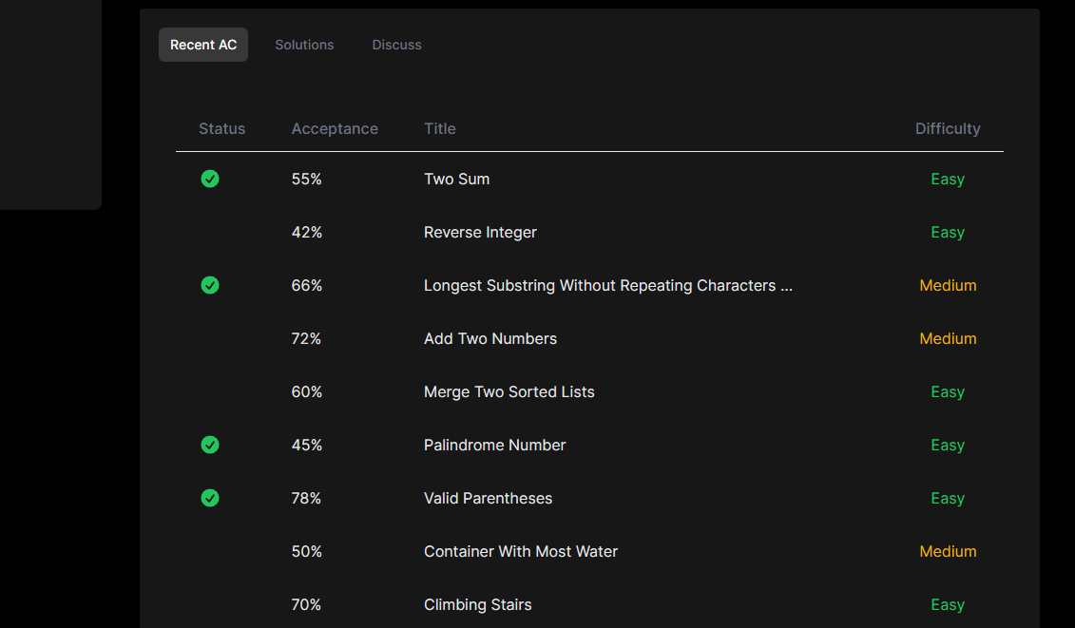
Profile Page:

Slide 17
Conclusion
The Remote Code Execution Engine revolutionizes the way developers tackle programming challenges. With its seamless integration with AWS auto scaling group and simple queue service, coupled with the use of Docker containers, it offers unmatched scalability, security, and efficiency. Empower your team today and unleash the true potential of your projects.

Slide 18



Thank You
Aarjav Jain
Lakshika Chaudhary
Manraj Singh
TCA2057001
TCA2057021
TCA2057022
Live Link
Github Repo

